Slide 1


VIDEO CONFERENCING SETUP GUIDE
Version 1.0

Slide 2
System Requirements
1. | Desktop having Windows operating system, web camera, microphone and speakers Or Laptop with windows operating system having Web Cam & Mic (Windows 7 Or Above)
2. | Internet connection with minimum 256 kbps speed
3. | Google Chrome
4. | InstaVC Desktop Sharing Extension

Slide 3
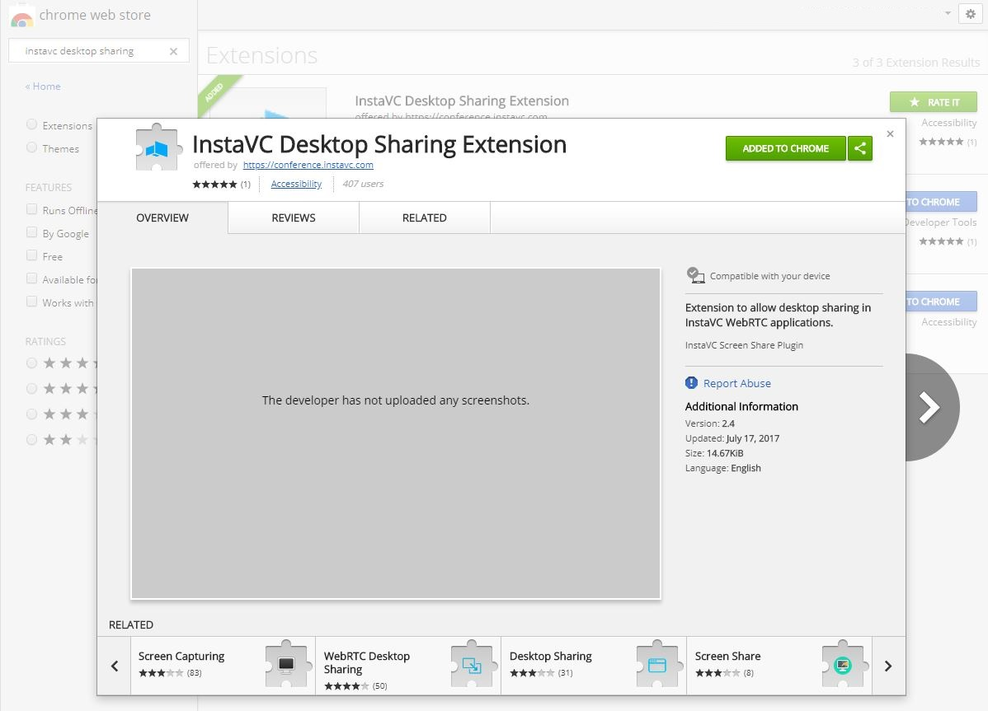
Install InstaVC Extension
Visit : https://chrome.google.com/webstore/category/extensions and download the InstaVC Desktop Sharing Extension
Click Here

Slide 4
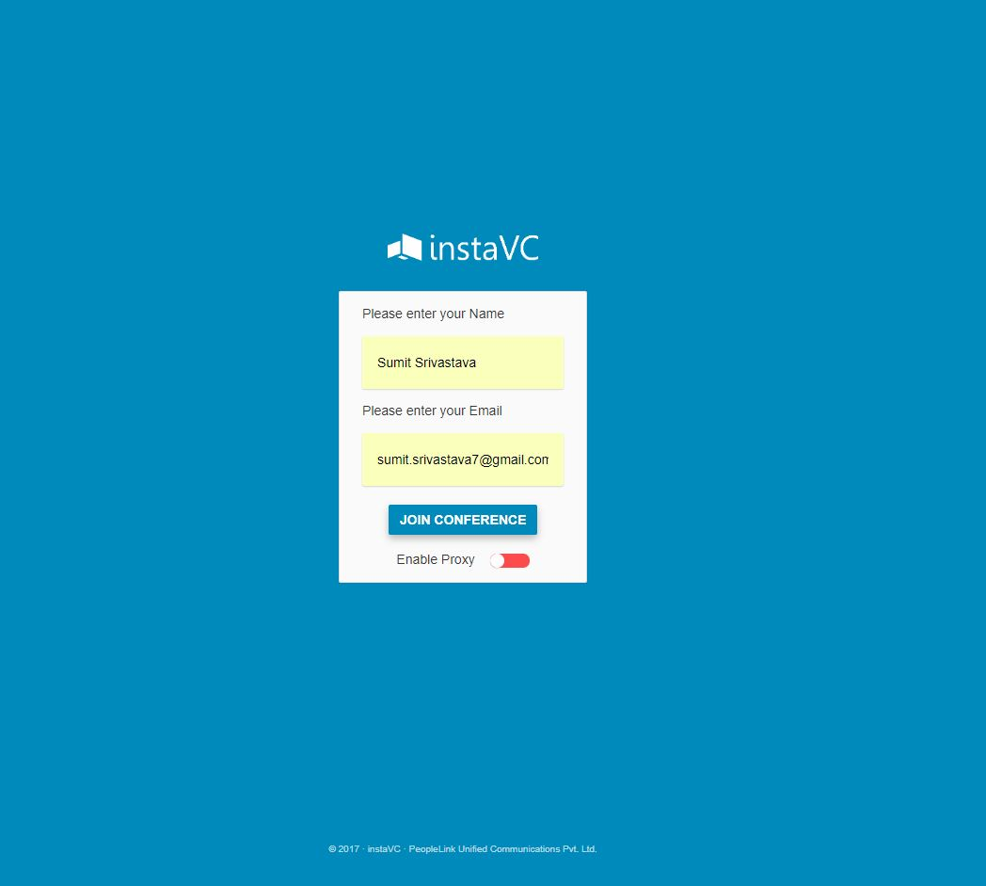
Login Screen
Open the URL given in the Invitation Email, following screen will get appeared
Enter Your Name and Email
Click on “Join Conference“ button
(Screen-01)

Slide 5
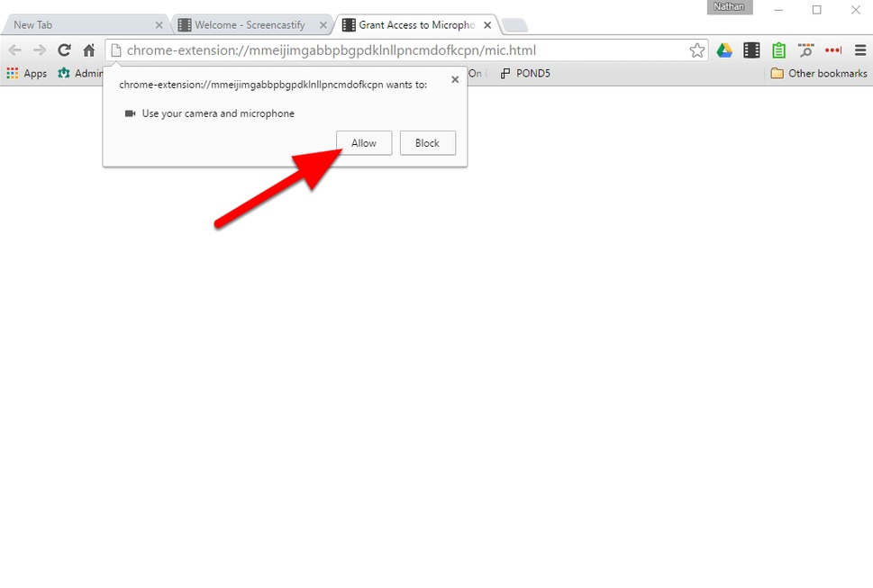
Conference Access
2. Now click on allow button to grant access to use your camera and microphone
Click on “Submit” button
(Screen-02)

Slide 6
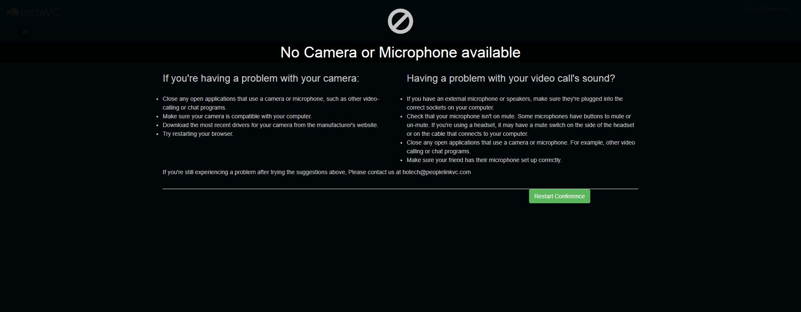
If no camera or microphone is connected
3. This option will appear if no camera or mic is connected, make sure AV devices are properly connected.
Click on “Restart Conference“ button
(Screen-03)

Slide 7
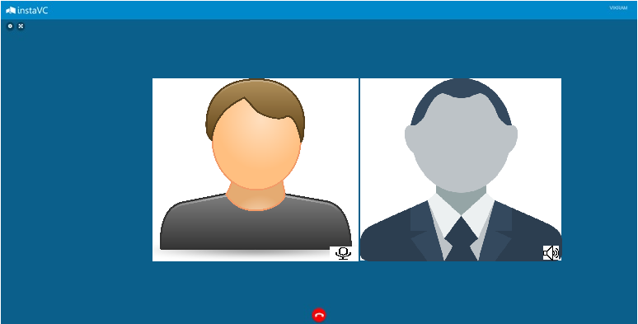
Welcome Screen
4. Now you will be connected to the conference, you may change the audio/video settings if required.
Click here to full screen
Click here to change Audio/Video Settings
Agent’s View
Controller’s View
Click on “Mic“ icon to share your voice
Click to mute/un-mute the
speaker volume
Click here to end the conference
(Screen-04)

Slide 8
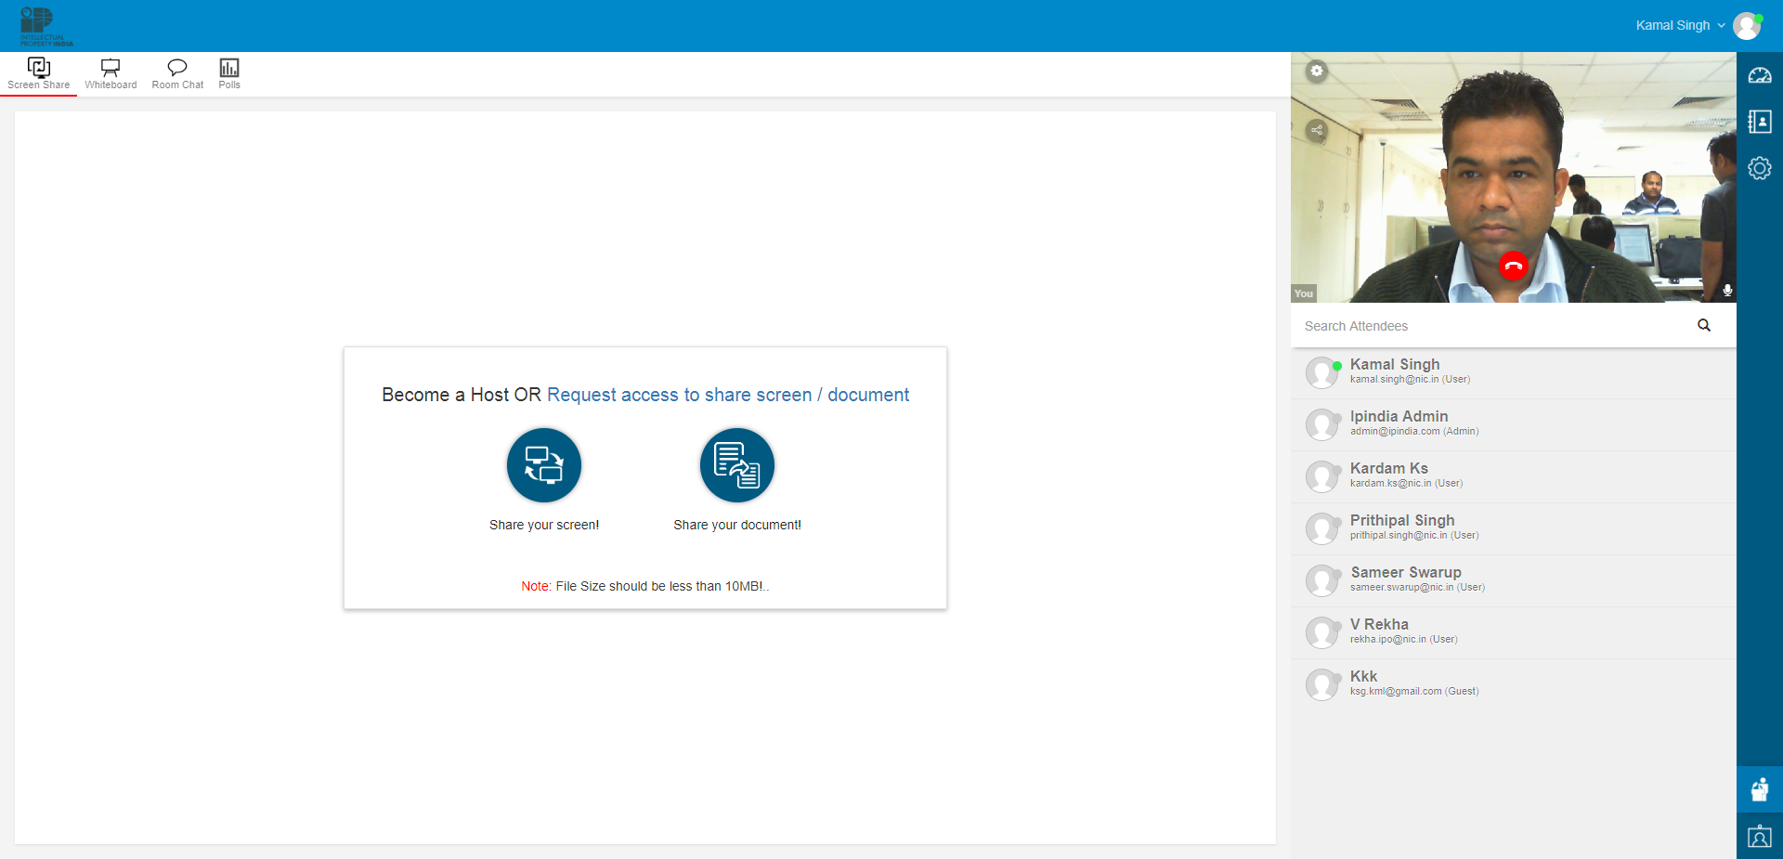

Document Sharing
5. For sharing any document during the conference, user may request the controller.
Click here to request the controller
(Screen-05)

Slide 9
Document Sharing Contd...
6. Once the request is granted, click on “Share your document” icon
Click to browse the document
(Screen-06)

Slide 10
Screen Sharing
7. Once the request is granted, click on “Share your screen” icon
Click to share your screen
Click to “change the layout”
(Screen-07)

Slide 11
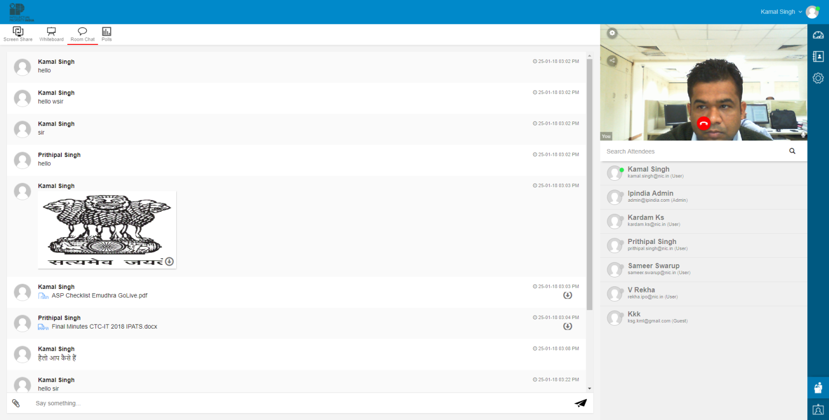
Room Chat
8. User may type in the chat box if there is any technical issue or may share document
Click to browse the document
(Screen-08)

Slide 12
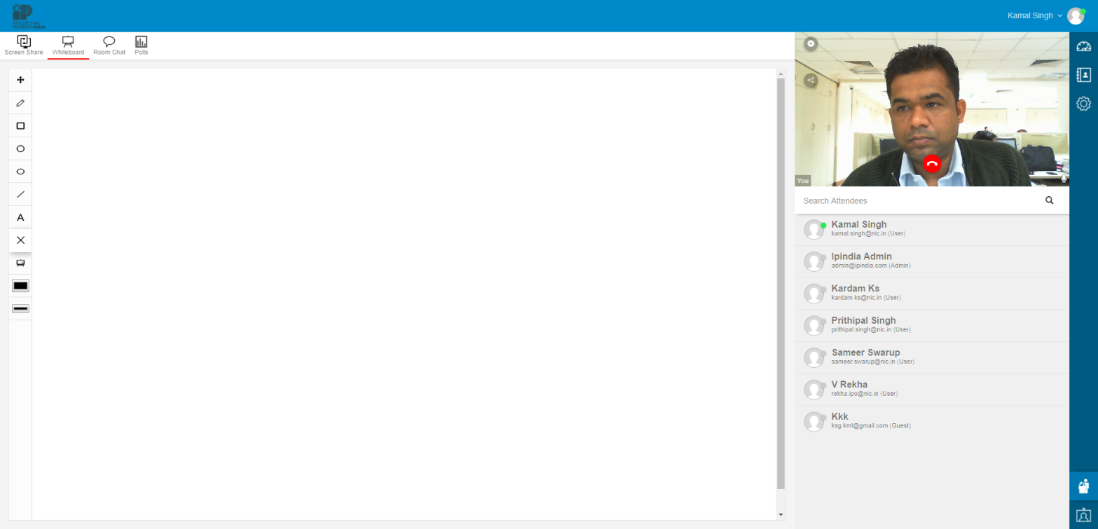
White Board
9. User may explain by drawing on Whiteboard.
Drawing Tools
White Board
Click on “Mic“ icon to share your voice
(Screen-09)

Slide 13
THANKS...
Help Desk: ipo-helpdesk@nic.in

